Slide 1
Lesson 4: Enhanced Entity-Relationship
Model
CSC430/530 – DATABASE MANAGEMENT SYSTEMS

Slide 2
OUTLINE
Enhanced entity relationship model.
Subclasses & superclasses.
Specialization & generalization.
Specialization & generalization constraints.
Hierarchies & lattices.
Categories.

Slide 3
INTRODUCTION
Enhanced (extended) ER model aims to design more accurate database schemas.
Allows more complex requirements to reflect data properties and constraints more precisely.
Includes all modeling concepts of basic ER model.
Additional concepts:
Subclasses & superclasses.
Inheritance of attributes & relationships.
Specialization & generalization.
Categories (UNION type).

Slide 4
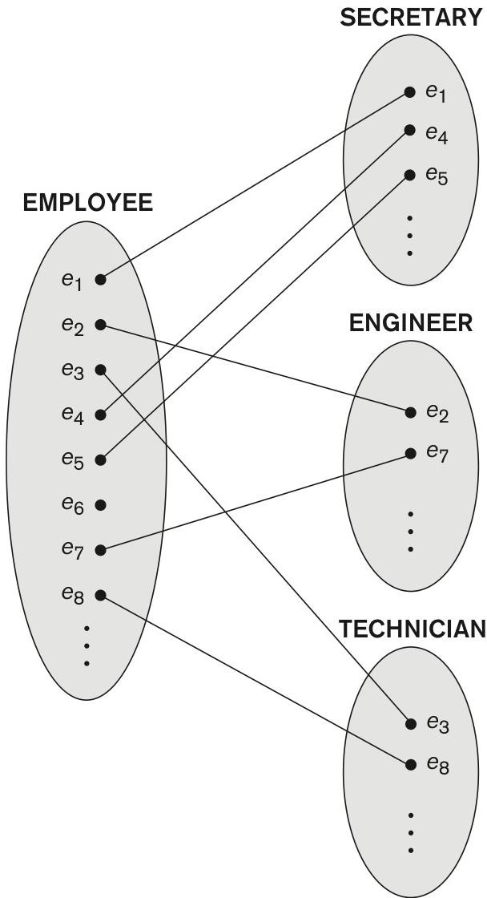
SUBCLASSES & SUPERCLASSES (1)
Subclass (subtype) - meaningful subgrouping of an entity type (superclass).
Represented explicitly because of the significance to the database application.
Inherits all attributes & relationships of superclass.
Type inheritance.
Example:
EMPLOYEE entity type subdivided into:
SECRETARY, ENGINEER, TECHNICIAN.
Based on job title.
MANAGER.
Based on role.
SALARIED_EMPLOYEE, HOURLY_EMPLOYEE.
Based on method of pay.
Superclass and subclasses

Slide 5
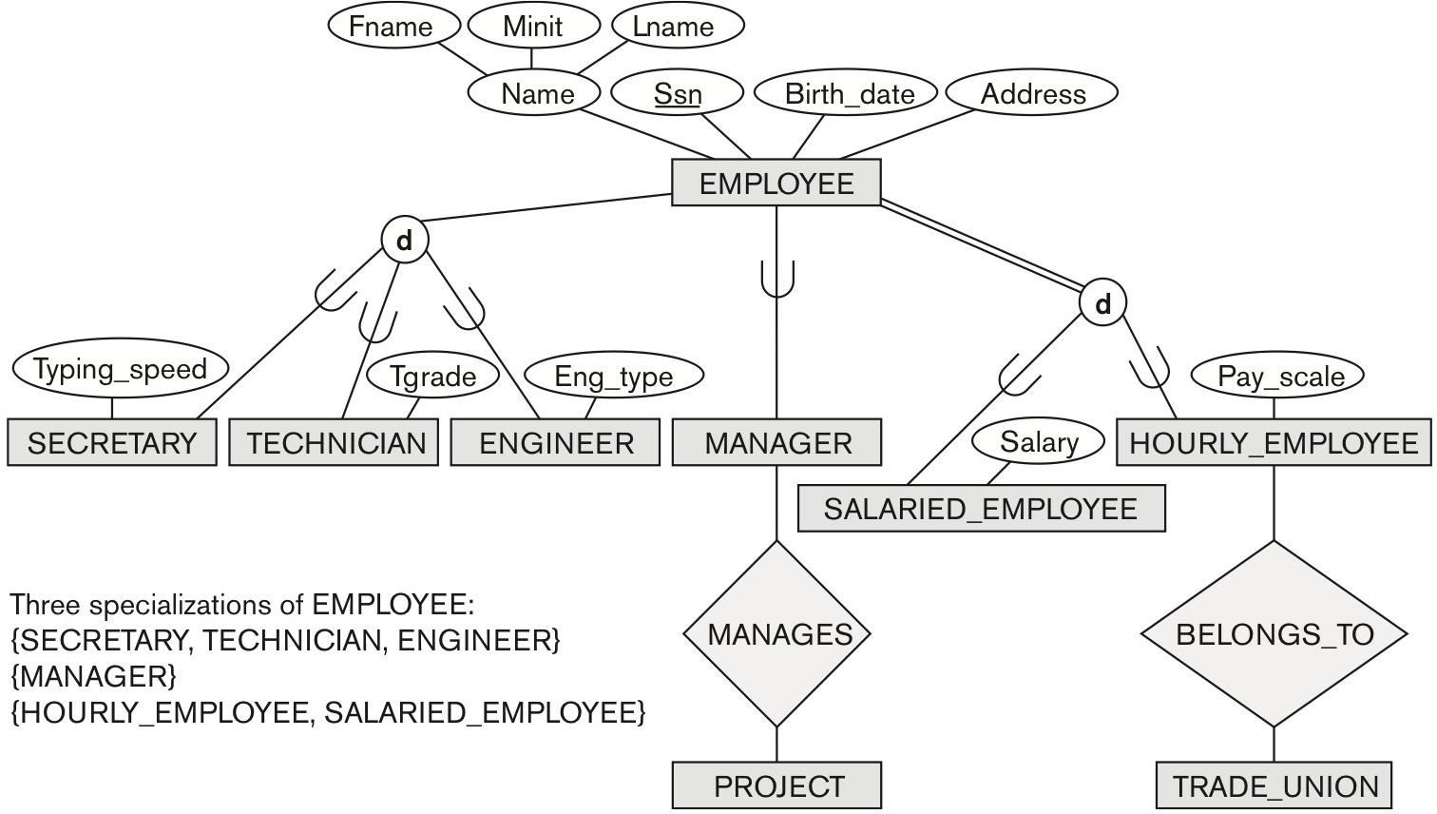
SUBCLASSES & SUPERCLASSES (2)
EER diagram of COMPANY database

Slide 6
SUBCLASSES & SUPERCLASSES (3)
Subclass entity represents the same real-world entity as members of the superclass.
Subclass member is the same entity, but in a distinct specific role.
An entity cannot exist in the database merely by being a member of a subclass.
It must also be a member of the superclass.
A member of the superclass can be optionally included as a member of any number of its subclasses.
It is not necessary that every entity in a superclass be a member of some subclass.

Slide 7
SPECIALIZATION
Specialization is the process of defining a set of subclasses of a superclass.
Based on some distinguishing characteristics of the entities in the superclass.
Examples of EMPLOYEE specializations:
{SECRETARY, ENGINEER, TECHNICIAN}.
Based on job type.
{MANAGER}.
Based on role.
{SALARIED_EMPLOYEE, HOURLY_EMPLOYEE}.
Based on method of pay.
EMPLOYEE entity type specializations

Slide 8
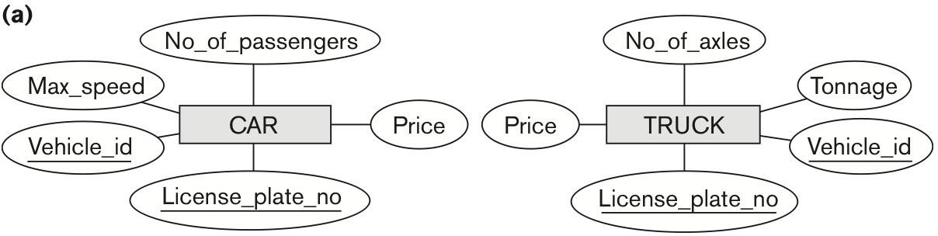
GENERALIZATION
Generalization is the reverse of the specialization process.
Several classes with common features can be generalized into a superclass.
Original classes become subclasses of superclass.

Slide 9
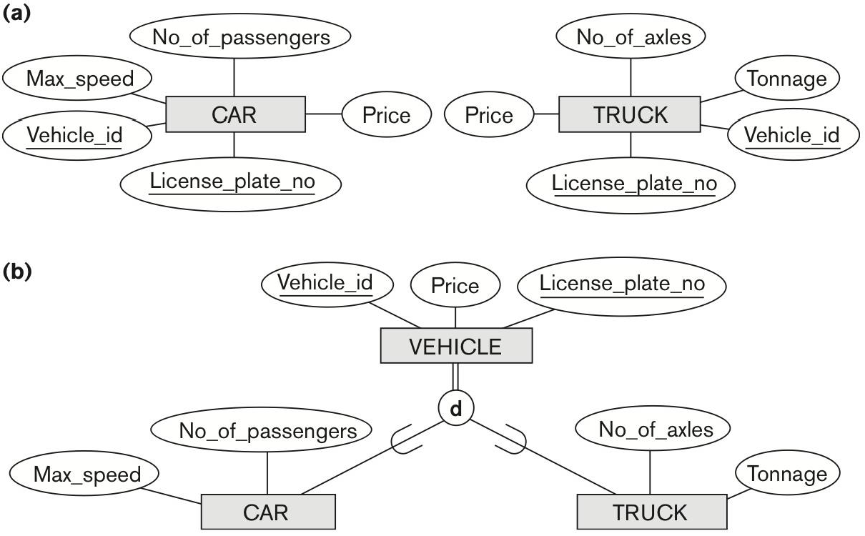
GENERALIZATION
Generalization is the reverse of the specialization process.
Several classes with common features can be generalized into a superclass.
Original classes become subclasses of superclass.
Example:
CAR, TRUCK generalized into VEHICLE.
Both CAR, TRUCK become subclasses of the
superclass VEHICLE.
VEHICLE is a generalization of CAR and TRUCK.
{CAR, TRUCK} is a specialization of VEHICLE.
CAR and TRUCK Generalization

Slide 10
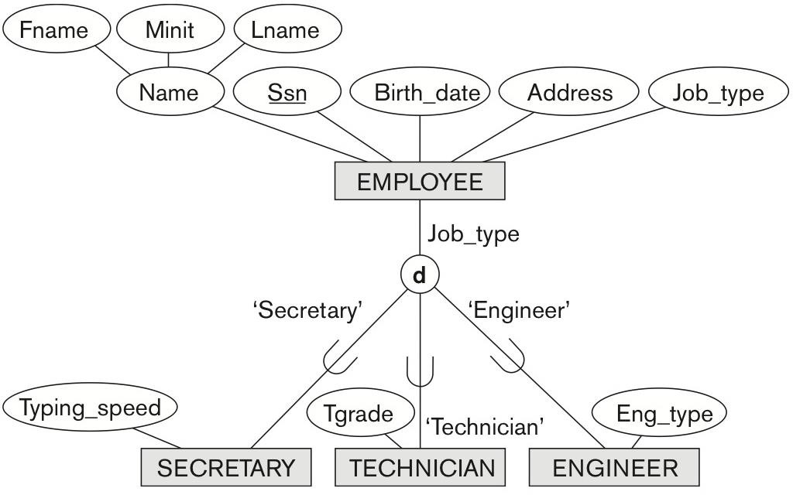
TYPES OF SPECIALIZATION & GENERALIZATION
Specialization/generalization types:
Predicate-defined (condition-defined).
Based on defining predicate.
Job_type = ‘Secretary’.
Attribute-defined.
Based on defining attribute.
User-defined.
Defined by the user on an entity by entity basis.
EMPLOYEE entity type specializations

Slide 11
SPECIALIZATION & GENERALIZATION CONSTRAINTS (1)
Specialization & generalization have two types of constraints:
Disjointness constraint.
Specialization/generalization can be disjoint or overlapping.
Completeness constraint.
Specialization/generalization can be total or partial.

Slide 12
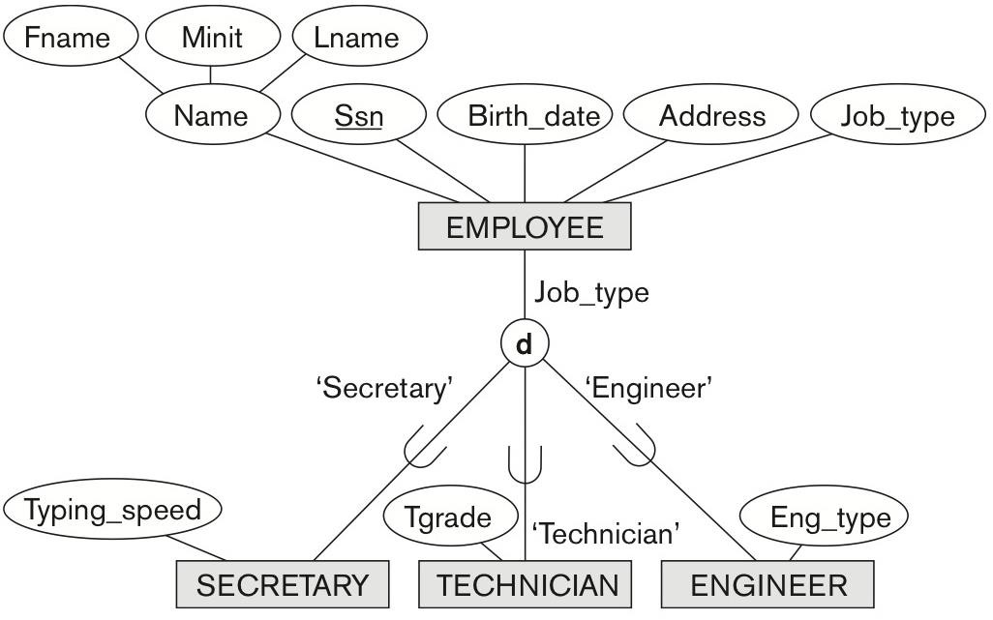
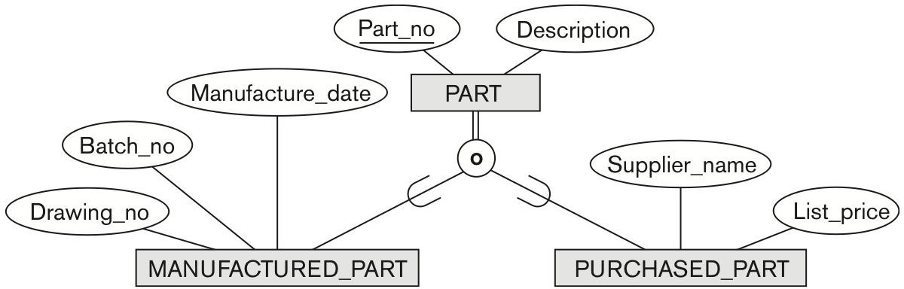
SPECIALIZATION & GENERALIZATION CONSTRAINTS (2)
Disjointness constraint.
Disjoint sets.
Entity can be a member of at most one of the subclasses of the specialization.
Specified by d in EER diagram.
Overlapping sets.
Entity may be a member of more than one subclass of the specialization.
Specified by o in EER diagram.
Disjoint specialization
Overlapping specialization

Slide 13
SPECIALIZATION & GENERALIZATION CONSTRAINTS (3)
Completeness constraint.
Total.
Every entity in the superclass must be a member of some subclass in the specialization/generalization.
Shown in EER diagrams by a double line.
Partial.
Allows an entity not to belong to any of the subclasses.
Shown in EER diagrams by a single line.
Disjointness and completeness constraints are independent.
Disjoint total.
Disjoint partial.
Overlapping total.
Overlapping partial.

Slide 14
HIERARCHIES & LATTICES (1)
A subclass may have its own subclasses.
Forms a hierarchy or a lattice.
Hierarchy.
Every subclass has only one superclass.
Single inheritance.
Tree-like structure.
Lattice.
Subclass can have more than one superclass.
Subclass that has more than one superclass is called a shared subclass.
Multiple inheritance.
Graph-like structure.
In a lattice or hierarchy, a subclass inherits attributes not only of its direct superclass, but also of all its predecessor superclasses.

Slide 15
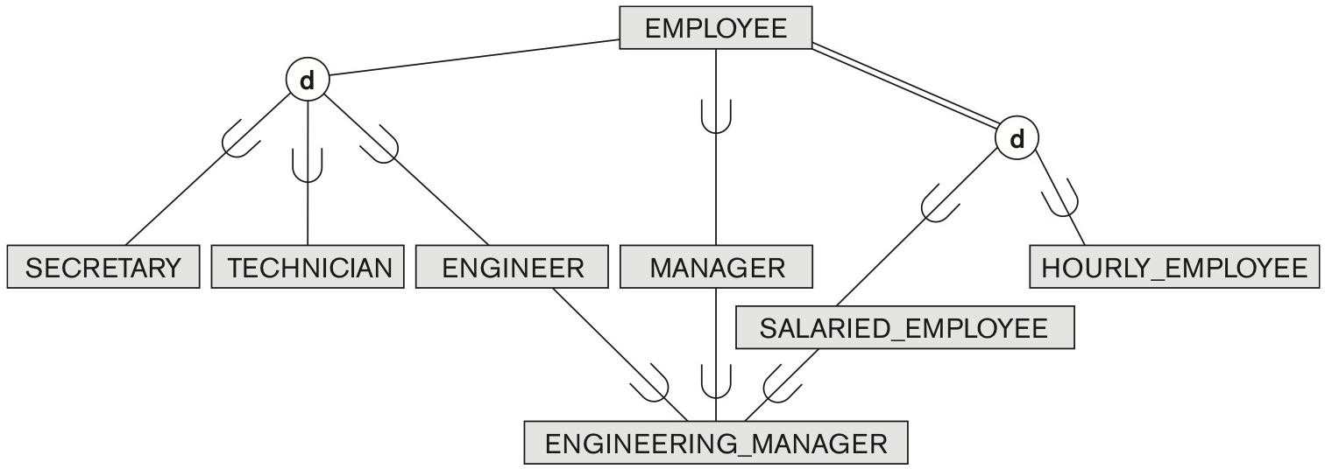
HIERARCHIES & LATTICES (2)
Example:
ENGINEERING_MANAGER is a shared subclass that inherits from three superclasses ENGINEER, MANAGER and SALARIED_EMPLOYEE.
Specialization lattice with ENGINEERING_MANAGER shared subclass

Slide 16
HIERARCHIES & LATTICES (3)
ER schema can be further refined into EER schema in two ways:
Top-down conceptual refinement.
Based on specialization.
Start with an entity type and then define subclasses of the entity type by successive specialization.
Bottom-up conceptual synthesis.
Based on generalization.
Start with many entity types and generalize those that have common properties.
In practice, a combination of both processes is employed.

Slide 17
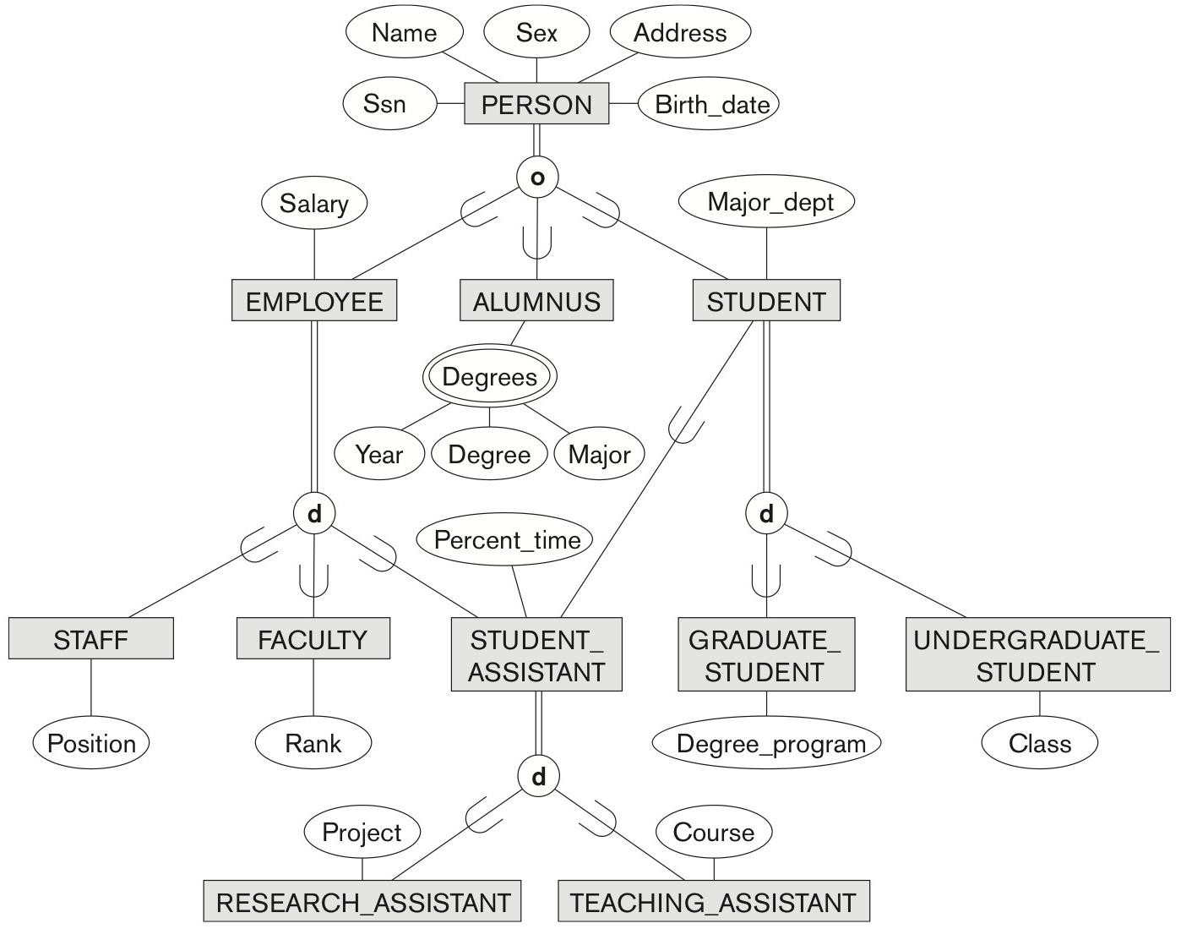
HIERARCHIES & LATTICES (4)
Specialization lattice with multiple inheritance for a UNIVERSITY database

Slide 18
CATEGORIES / UNION TYPES (1)
Category (union type).
In some cases it is necessary to represent a collection of entities from different entity types.
Subclass represents a collection of entities that is a subset of the UNION of entities from distinct entity types.
Example.
In a database for vehicle registration, a vehicle owner can be a PERSON, a BANK or a COMPANY.
OWNER category (union type) is created to represent a subset of the union of the three superclasses COMPANY, BANK, and PERSON.
A category member must exist in at least one (typically just one) of its superclasses.

Slide 19
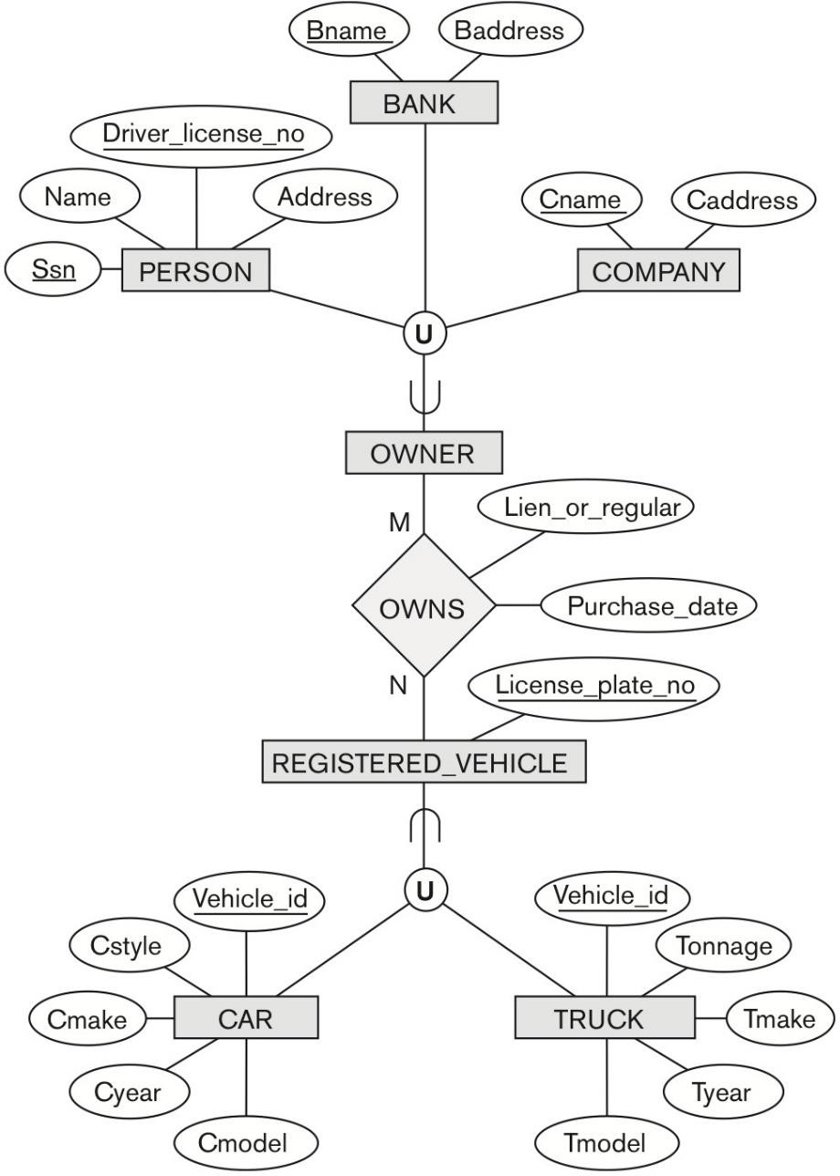
CATEGORIES / UNION TYPES (2)
Example (cont.)
OWNER category (union type).
Union of BANK, PERSON, and COMPANY entity types.
REGISTERED_VEHICLE category (union type)
Union of CAR and TRUCK entity types.
Two Categories OWNER and REGISTERED_VEHICLE

Slide 20
EER DESIGN GUIDELINES
Guidelines for the EER design process:
More specializations and subclasses = more accurate conceptual model.
Drawback – cluttered design.
Subclass with few specific (local) attributes / no specific relationships is merged into superclass.
Specific attributes = NULL values for entities that are not members of the subclass.
A type attribute can be used to specify the subclass.
The choice for disjoint/overlapping and total/partial constraints is driven by the rules in the mini-world.
No particular constraints = overlapping and partial.

Slide 21
SUMMARY
Enhanced ER model.
Subclasses & superclasses.
Specialization & generalization.
Predicate-defined, attribute-defined, and user-defined.
Constraints on specialization & generalization.
Disjointness & completeness.
Hierarchies & lattices.
Single inheritance / multiple inheritance.
Categories (union types).

